Slide 1


Role Assignment in IoT through Accelerated Hardware
Md. Fasiul ALAM and S. Hadjiefthymiades
Pervasive computing research lab
University of Athens
IOTSMS 2018
Valencia, Spain

Slide 2
IoT in-network processing
Roles assigned to IoT nodes to facilitate data transformation along their path to the application. Examples: event detection, fusion, aggregation.
Nodes (roles) are chained, subject to the current network topology, to form an in-network workflow.
Use of accelerated hardware to efficiently managed the delegated tasks (roles), optimize the energy use and promptly react to topological changes.

Slide 3
Accelerator types
Parallel processors
FPGA boards
GPUs
Benefits: min energy overhead per instruction, parallel execution of tasks, limited overhead for setting up/dropping in-network processing duties.

Slide 4

Node structure
Onboard
Sensors
Processor
Accelerator
Network (up, downstream)
BUS
User Interface support

Slide 5
FPGA support to IoT tasks
Task functionality is programmed into the FPGA
Tasks can be realized in parallel (within the FPGA)
Processor programming: bare-metal or OS based using languages like Java.
FPGA design: VHDL or HLS
Memory mapped connectivity between processing element and FPGA
Different tasks can be programmed in advance and deployed on demand.

Slide 6
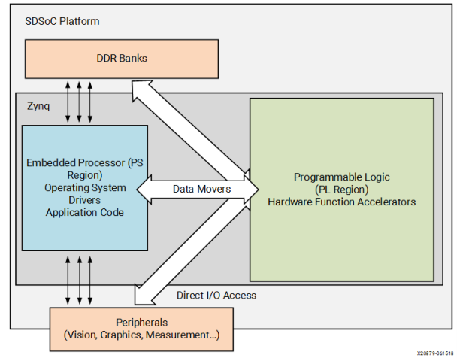
FPGA connectivity

Slide 7
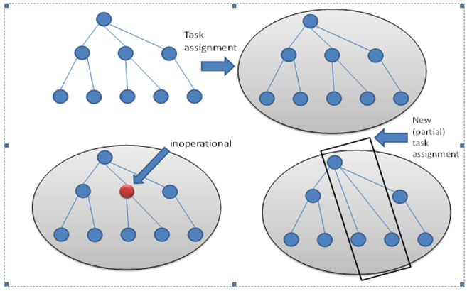
Dynamic topology & reassignments

Slide 8
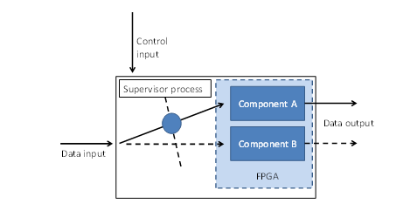
Reassignment realization

Slide 9
Delays
* Dominant delay factor: the communication interface between the host processor and the FPGA (affected data passing and reprogrammability)
* Our experiments demonstrated sustained rates of 461 MB/s for PL clocking at 125 MHz

Slide 10
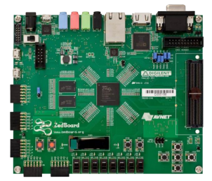
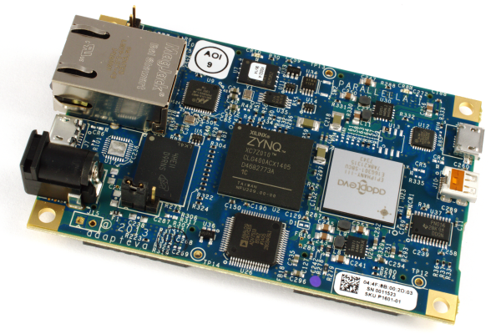
Experimentation Platforms
Zedboard …
but also Parallela

Slide 11
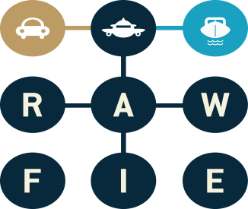
Questions?
ACK: This research has been funded by the European Commission (Horizon H2020 programme) under the RAWFIE (Road-, Air-, and Water- based Future Internet Experimentation) [20] project an initiative that aims for Future Internet Research Experimentation for Internet of Things (IoT) devices..
www.rawfie.eu
p-comp.d.uoa.gr

