Slide 1
An Intelligent scheme for Outliers’ detection on a Cloudlet
Dimitrios Milios , M1384
Supervisor: Efstathios Hadjiethythimiades , Associate Professor NKUA

Slide 2
Thesis’ Outline
Cloud Computing
Mobile Cloud Computing
Cloudlet and Cooperative caching
Hilout with temporal approach for detection of Outliers
PCA dimension reduction
Variance per dimension
CloudSim simulation framework ,Experiments and results
Conclusions

Slide 3
Cloud Computing : Definition
Cloud Computing is :
a framework for sharing resources, information and software capabilities to different mobile devices.
a service where the resources will be available on the Cloud and can be shared by the devices on demand.
a model for enabling convenient, on-demand network access to Computing resources that can be rapidly provisioned and released with minimal management effort.

Slide 4
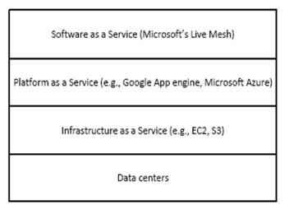
Cloud Computing : Classification Layers

Slide 5
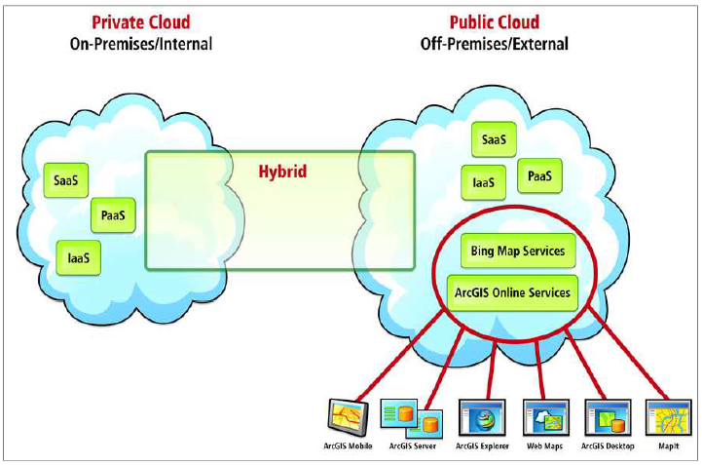
Cloud Computing : Models

Slide 6
Cloud Computing : Features
Scalability and On-Demand Services
Quality of Service (QoS)
User-Centric Interface
Autonomous System
Pricing – Cloud

Slide 7
Mobile Cloud Computing (MCC) : Definition
Mobile Cloud Computing :
refers to an infrastructure where both the data storage and data processing happen outside of the mobile device.
can be defined as a combination of mobile web and Cloud Computing, which is the most popular tool for mobile users to access applications and services on the Internet.
can be expressed by the Cloudlet concept : the mobile device offloads its workload to a local Cloudlet comprised of several multi-core computers with connectivity to the remote Cloud servers.

Slide 8
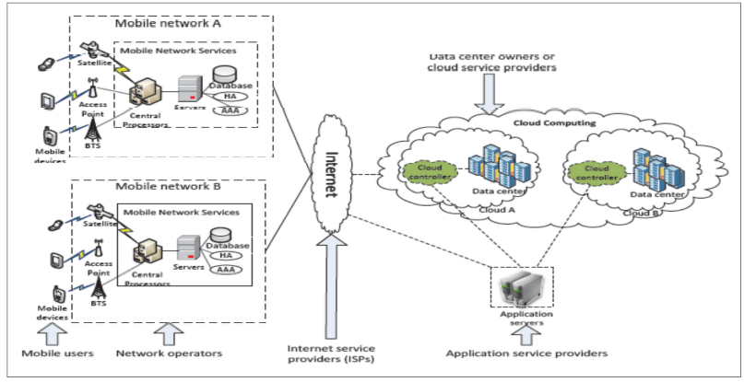
Mobile Cloud Computing : Architecture

Slide 9
Mobile Cloud Computing : Models
Client Model: mobile device act as client and mobile user access service is offered by Cloud by thin layer of interface web browser.
Client / Cloud Model: the concept of task partitioning comes in which mobile users give a part of task to Cloud for processing.
Cloud Model: mobile device itself is the part of Cloud. One or more mobile devices create the structure of Cloud.

Slide 10
Mobile Cloud Computing : Major Features -Advantages
Flexibility/Elasticity
Scalability of Infrastructure
Broad Network Access
Location Independence
Reliability
Decrease WAN latency
Storage , computing and power resource of mobiles

Slide 11
Mobile Cloud Computing : Challenges(1/2)
Low Bandwidth
Security and Privacy in the Cloud
Prone to Attack
Dependency and Vendor Lock-In
Limited Control and Flexibility
Increased Vulnerability
Loss of connection
Bandwidth/Latency
Limited resources

Slide 12
Mobile Cloud Computing : Challenges (2/2)
Recommended solutions for the challenges are given regarding :
Privacy and Confidentiality
Data Integrity
Data Location and Relocation
Data Availability
Not sufficient solutions are not given yet regarding :
Supporting continuous mobility while ensuring connectivity to the Cloud
Security in Mobile Clouds
Incentives for surrogates

Slide 13
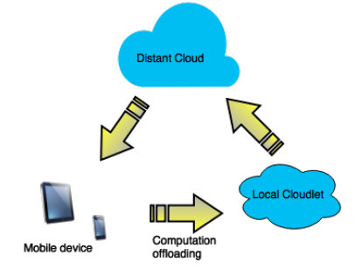
Cloudlet : Definition and Architecture
Cloudlet: is a computer or a cluster of computers connected at the edge of the network to provide low-latency access to Computing resources for mobile devices.
Cloudlet architecture : Cloudlet is considered as the middle tier of a 3-tier hierarchy: mobile device, Cloudlet and Cloud.

Slide 14
Cloudlet : Infrastructure types
VM based approach :
A mobile user exploits virtual machine (VM) technology to rapidly instantiate customized service software on a nearby Cloudlet and then uses that service over a wireless LAN, the mobile device typically functions as a thin client with respect to the service.
A Cloudlet is a trusted, resource-rich computer or cluster of computers that’s well-connected to the Internet and available for use by nearby mobile devices.
Dynamic VM synthesis :
A mobile device delivers a small VM overlay to the Cloudlet infrastructure that already possesses the base VM from which this overlay was derived.
The infrastructure applies the overlay to the base to derive the launch VM, which starts executing in the precise state in which it was suspended.

Slide 15
Cloudlet : Models and Challenges
Cloudlet Models :
ad hoc Cloudlet
elastic Cloudlet
Cloudlet Challenges :
remains dependent on service providers to actually deploy such Cloudlet infrastructure in LAN networks . Recommended solution : a more dynamic Cloudlet concept is proposed , where all devices in the LAN network can cooperate in the Cloudlet
the coarse granularity of VMs as unit of distribution. Recommended solution : better performance can be achieved by dynamically partitioning the application in components.
resources in the Cloudlet still limited . Recommended solution : component offloading, a more flexible allocation of the Cloudlet resources is possible, so that priority is given for latency-critical parts of the application, while non real-time parts can be offloaded to a more distant Cloud.

Slide 16
Cooperative Caching
Definition :
is based on the idea of demanding the necessary data from a neighbor node in the network instead of the original resource.
different approaches have been proposed for cooperative caching, such as, caching on mobile nodes, caching on intermediate or proxy nodes or caching on the edge of network.
in Mobile Cooperative Caching, mobile devices try to form an ad hoc network with other mobile nodes in the proximity to share the relevant data.
Advantages :
Cooperative caching improves the response time by reducing VM synthesis time by caching the previous state.
Distributed caches permits a system to deal with concurrent client request as well as sharing contents.
Data caching increases battery life in mobile devices by reducing wireless communication.

Slide 17
Cloudlet Scenario : Detection of Outliers (1/2)
Use of CloudSim simulation framework
Cloudlet : is considered as a repository : a MySQL schema table
Input : data-vectors , data from IoT devices, with values : multiple dimensions- coordinates. They arrive sequentially.
Hilout Algorithm decides if an incoming vector is outlier or not. If it is , it is marked as such and it stored in the repository.

Slide 18
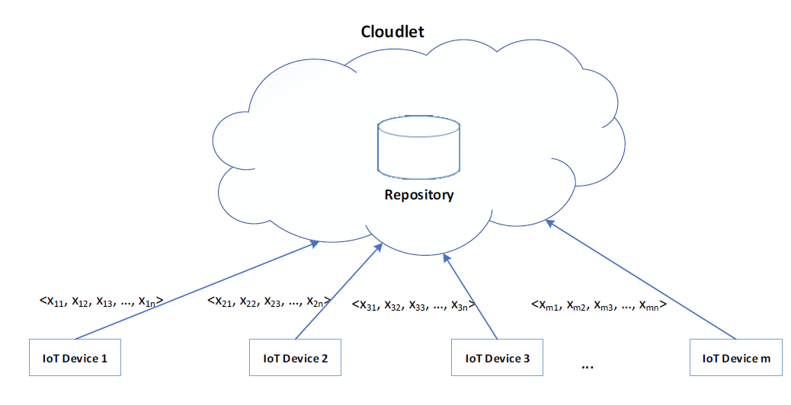
Cloudlet Scenario : Detection of Outliers (2/2)

Slide 19

Hilout Algorithm
Original Hilout Algorithm : Hilout finds distance-based Outliers, but uses the ranks of distance instead of the absolute distance in outlier detection. The weight of object o is defined as:
Hilout Algorithm with temporal approach :
Not only the spatial proximity with the neighbors is taken into account for the decision but also the temporal proximity.
If the neighbors' timestamps are not within a time window W, an extra penalty is added to the weight of each of the neighbors-vectors accordingly.

Slide 20
Hilout Algorithm : Steps
A new data-vector wants to enter the cloudlet
The number of neighbors is decided. The number of the neighbors(k) is randomized between the half and the total number of vectors of the current dataset that is stored in the repository.
We find the neighbors according to the proximity of them comparing to the input vector's position, as the Hilout algorithm defines.
If the weight of the incoming vector is the highest, then it is marked as an outlier and is stored in the repository with weight 0. If it is not an outlier, then the weights of the neighbors are updated (plus the relative distance with the incoming vector) and the incoming vector is stored.

Slide 21
Hilout Algorithm : Calculation of weight
When the incoming vector arrives to the Cloudlet, the timestamp of it minus 1 millisecond becomes the time window (W)
If the timestamp of each neighbor is out of range of the W, then a penalty is added to its weight. There is no penalty for the incoming vector because its timestamp is one of the edges of the W.
The weight of the incoming vector is only the sum of the relative distance with its neighbors but the weight of the neighbors is the sum, relative distance with the incoming vector is not taken into account, plus the possible penalty due to the time window.

Slide 22
Input Data
The input data, follow the Gaussian distribution. Each dimension's value is given, in the code, by the formula: mean * randomNumber * deviation.
the randomNumber is given by the Random number generator of Java
The deviation is set from the set {5,25,50}
For every 10 data vectors that are inserted, Outliers or not, the mean deviates by a value that is given by the Exponential distribution. The deviation's is given, in the code, by the formula:
(log (1- randomNumber)) / (-lambda). The lambda is set from the set {0.2,5}, the randomNumber is given by the Random number generator of Java and it must be double type and the log is the logarithm with base e.

Slide 23
PCA dimension reduction
Principal component analysis (PCA) is the main linear technique for dimension reduction.
It reduces the data down into its basic components, stripping away any unnecessary parts. It actually finds the principal components of data.
So what are principal components then? They’re the underlying structure in the data. They are the directions where there is the most variance, the directions where the data is most spread out.

Slide 24
Hilout with PCA : Steps
A new data-vector wants to enter the cloudlet
The number of neighbors is decided. The number of the neighbors(k) is randomized between the half and the total number of vectors of the current dataset that is stored in the repository.
We find the neighbors according to the proximity of them comparing to the input vector's position, as the Hilout algorithm defines .The difference this time is that we apply the PCA method on all the records, which are not Outliers, of the dataset, expect the incoming vector, and we find the principal components of the dataset.
Decision if it is an outlier is taken : If the weight of the incoming vector is the highest, then it is marked as an outlier and is stored in the repository with weight 0. If it is not an outlier, then the weights of the neighbors are updated (plus the relative distance with the incoming vector) and the incoming vector is stored.

Slide 25
PCA : example
Records :
1st record: {96.93,95.04,96.15,99.04}
2nd record: {93.94,106.34,101.99,94.39}
3rd record: {92.98,96.68,101.29,103.75}
4th record: {108.43,92.9,94.11,92.56}
PCA Components :
PCA1 PCA2 PCA3 PCA4
dim1: [[-0.50, -0.50, -0.50, -0.50],
dim2: [0.86, -0.36, -0.29, -0.21],
dim3: [0.09, 0.64, 0.04, -0.77],
dim4: [-0.01, -0.47, 0.81, -0.35]]

Slide 26
Variance per Dimension
Another characteristic we study in this Thesis is the Variance per dimension.
Variance (commonly denoted σ²) is a very useful measure of the relative amount of ‘scattering’ of a given set. In other words, knowing the Variance can give you an idea of how closely the values in a set cluster around the mean.

Slide 27
Goals of our scheme
Goals :
how the number of the data vectors affects the number of Outliers that are detected
how the number of the dimensions affects the number of Outliers that are detected
how the deviation of the mean in the Gaussian distribution affects the number of Outliers that are detected
how the lambda parameter in the Exponential distribution affects the number of Outliers that are detected

Slide 28
Why we chose this scheme
Hilout Algorithm : has been designed to efficiently detect the top n Outliers
Cloudlet : the centralized nature of the Cloudlet repository has advantages such as :
Data Integrity
Cost effectiveness
Increased efficiency
Enhanced data quality
Changeability
Accessibility

Slide 29
CloudSim Framework
CloudSim framework is a programming tool designed to normalize and accelerate the process of conducting experimental studies using Cloud Computing environments.
By using CloudSim, researchers and industry-based developers can focus on specific system design issues that they want to investigate, without getting concerned about the low level details related to Cloud-based infrastructures and services.
Important classes that are provided : Cloudlet , Host , DataCenter etc.
In our experiments we have only one configuration: a datacenter with one host and run one Cloudlet on it.

Slide 30
Experiments’ Configurations
2 cases :
Hilout with temporal approach
Hilout with temporal approach with PCA
Vectors | Dimensions | Deviation | Lambda
50,100,500,1000 | 2 - 10 | 5 | 0.2
50,100,500,1000 | 2 - 10 | 5 | 5
50,100,500,1000 | 2 - 10 | 25 | 0.2
50,100,500,1000 | 2 - 10 | 25 | 5
50,100,500,1000 | 2 - 10 | 50 | 0.2
50,100,500,1000 | 2 - 10 | 50 | 5

Slide 31
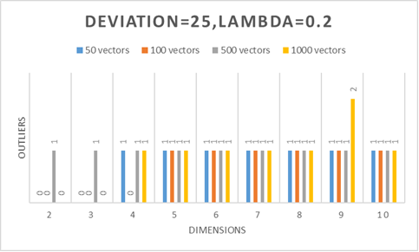
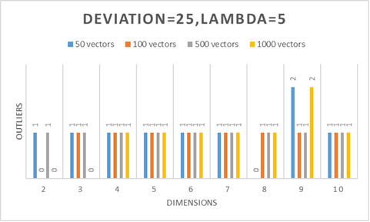
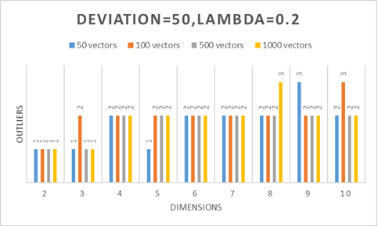
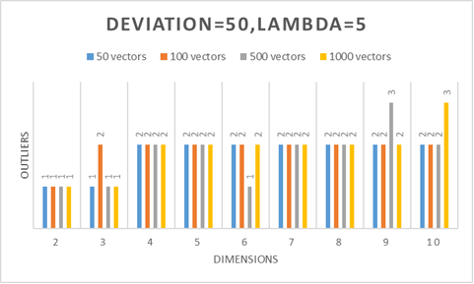
Results for case without PCA

Slide 32
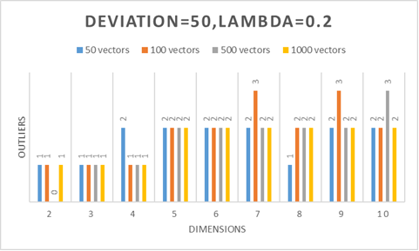
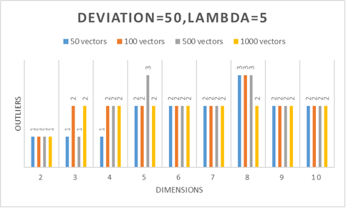
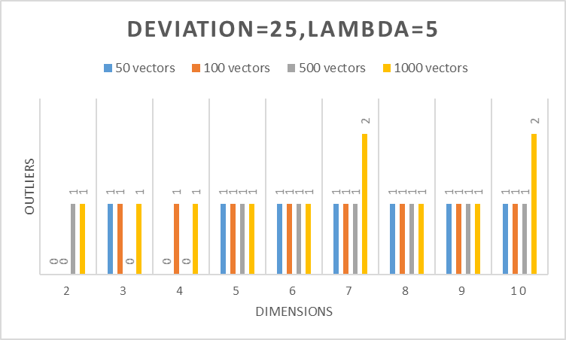
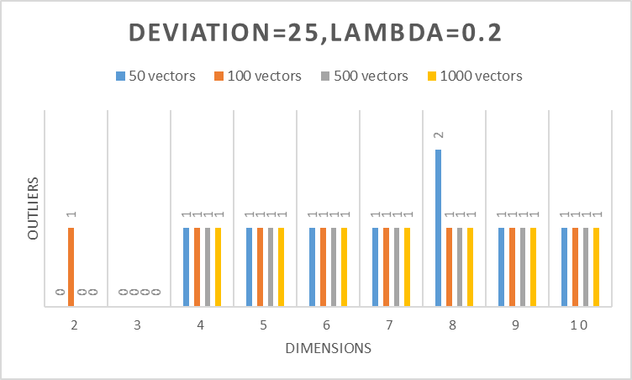
Results for case with PCA

Slide 33
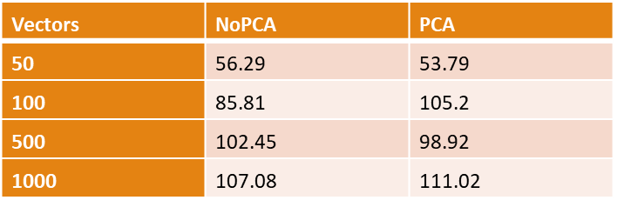
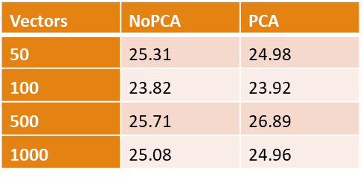
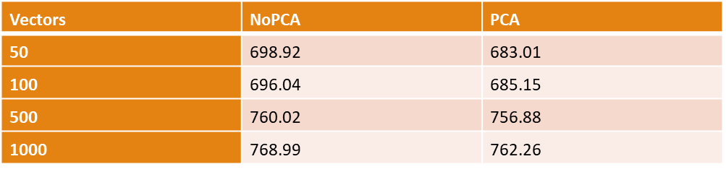
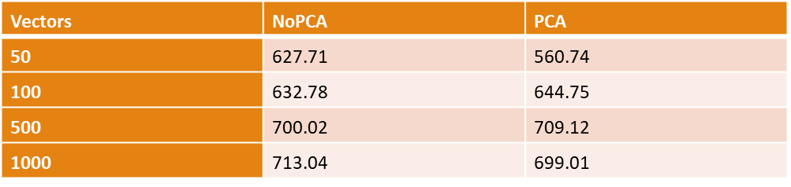
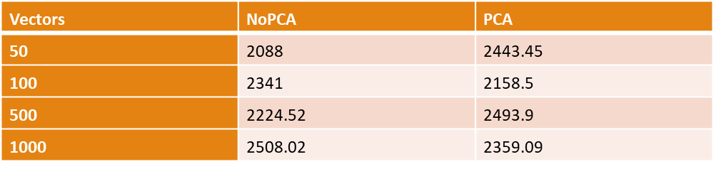
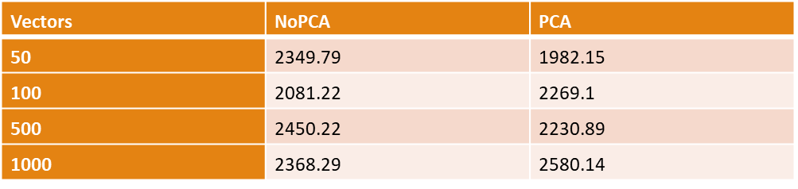
Variance per dimension : Results
Deviation : 5 , lambda:0.2 Deviation : 5 , lambda:5 Deviation : 25 , lambda:0.2
Deviation : 25 , lambda:5 Deviation : 50 , lambda:0.2 Deviation : 50 , lambda:5

Slide 34
Conclusions
We saw the concepts of Cloud Computing, Mobile Cloud Computing
We saw the concepts of a Cloudlet and of Cooperative Caching
We presented an intelligent scheme for detecting Outliers on a Cloudlet simulation environment by using Hilout Algorithm with a temporal approach
We saw the definition of PCA dimension reduction
We presented the results of the experiments we did. We had 2 main cases: Hilout applied without PCA, Hilout applied with PCA.
The results showed that the most important factor is the deviation parameter and more Outliers are detected on average while it increases. The case with PCA gave more or less similar results with the simple case. In our results we provided also the Variance per dimension in order to provide some statistical conclusions regarding the different configurations.

Slide 35
Thank you !!! Questions ?

