Slide 1


E-PreS: Monitoring and Evaluation of Natural Hazard Preparedness At School Community
An EU Co-Funded project
Contract Number: ECHO/SUB/2014/698447
http://e-pres.di.uoa.gr
http://p-comp.di.uoa

Slide 2
Coordinator and Partners
University of Athens, Greece (Coordinator)
Earthquake Planning and Protecting Organization, Greece (EPPO, participant)
University of Crete, National History Museum of Crete, Greece (NHMC – UoC, participant)
Istituto Nazionale di Geofisica e Vulcanologia sezione di Napoli Osservatorio Vesuviano (Vesuvius Observatory), Italy (INGV, participant)
Center for Educational Initiatives, Bulgaria (CEI, participant),
National Institute for Research and Development in Construction, Urban Planning and Sustainable Spatial Development, “URBAN-INCERC”, Romania (INCD-“URBAN INCERC”, participant)

Slide 3
Objective
To develop a trustworthy portable system which will enable the evacuation drill organizer to benchmark the evacuation process, pinpoint the evacuation scenario weak points and take remedial actions by modifying it. We focus on school evacuation drills due to earthquake, flood or volcanic eruption.
To improve evacuation awareness among students and the community.

Slide 4
The E-PreS Architecture
Sensor
Data stream
Data processing
Service
Web application
Components

Slide 5
The E-PreS Architecture
Sensor components
Include all components that operate inside a sensor unit.
Data stream components
Act as an intermediate level between the sensor and processing components and handle the data flow.
Data processing components
Process the data provided by the data stream components
Service components and web application componens
They are related to user interaction with the system (e.g., through a web browser the user is able to perform evacuation drill trials and make decisions)

Slide 6
Data processing Architecture (modified λ-architecture)
Batch layer
Serving layer
Master database
Batch view
Query
Batch view
New data
Speed layer
Real-time view
Query
Real-time view

Slide 7
Sensor components
Sensors are identifiable
Their readings and messages are available on demand
Messages and readings can be stored and retrieved
ID Detected
ID Detected
ID Detected
ID Detected
Message

Slide 8
Reader interface
It receives data from the sensing hardware connected to the sensors
Extracts required information
Transforms the information to a message pattern
Transmits the message to the message queue

Slide 9
Sensor message queue
Maintains the messages for a sufficient amount of time before transmitting them through the network
Ensures fast and reliable message delivery

Slide 10
Data stream components
Run on the mobile server, receive data from the sensors and deliver it to the other components of the server.
Handle massive amounts of data.
Comprise of a message queue and a message broker far more powerful from the queue on the sensor layer.
It is fast, reliable and able to repeat the process of receiving and transmitting messages.
Routes the incoming messages to batch and speed layer.

Slide 11
Server message queue
Receives messages simultaneously from different sources.
Maintains the messages for an adequate amount of time.

Slide 12
Batch layer – Persistent data storage
It stores all data received. The Persistent data storage receives all the data from the Message Broker concurrently with the speed layer, storing them for read-only operations.

Slide 13
Serving layer - Database
Stores all the data that is needed from the application or the users.
Provides insert, modify and delete operations for the actual data.
Answers to queries.
Creates and answers queries of the real-time feed
Provides administration permissions to other components and/or users

Slide 14
Service components
Provides functionalities for web application components (e.g., data analysis, registration services etc.)
All components run in the web application server, developed in a server-side scripting language.
Real Time Service
Data Analysis Service
Registration Service
Security Service

Slide 15
Web Application Components
Drill Registration/Modification Component
Drill Review Component
Real-Time Monitoring Component

Slide 16
Storm topology
A single piece of software that is deployed across a cluster.
A single executable filters data in one node, computes aggregates with a second node, and updates real-time view databases with a third.
Spout-Bolt abstraction: Spouts (streams) – Bolts (actions on streams. They produce streams themselves).
Very low latency (less than 10ms).
Focuses on business logic instead of coding for separate modules.

Slide 17
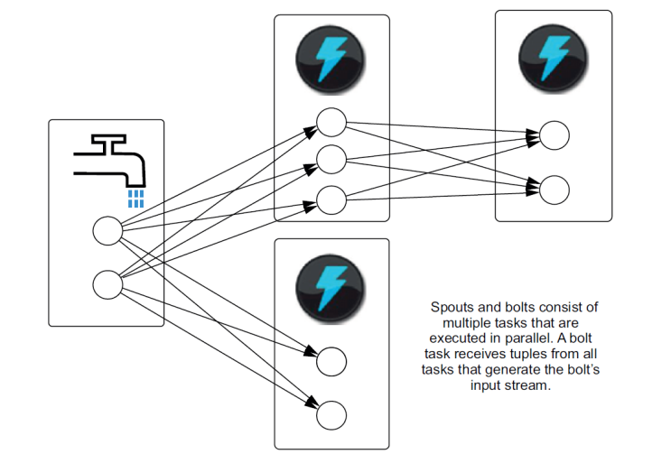
Storm topology

Slide 18

Use cases: The E-PreS System
Provide Credentials
Verify Credentials
Reject User
User
Create Drill
Modify/
Delete Drill
Review Drill
Blueprint
Antennas’ position
Blueprint
No of Students and Staff
No of Students and Staff
No of Students and Staff
Date and Time of Drill
Results
Antennas’ position
Antennas’ position
Review Drill
Date and Time of Drill
Date and Time of Drill

Slide 19
In a nutshell
Before the drill: Blueprints of the building are uploaded in the database. Checkpoints are set at strategically selected points and all related information is registered (e.g., number of students per classroom, maximum flux per checkpoint, etc.)
During the drill: Nodes are deployed at the building, powered up, the system software is started, Wi-Fi network is established and the nodes are registered at the system.
The drill is kick-started, the data collected provide the real-time view and are simultaneously stored for later processing.
After the drill: master database is updated

Slide 20
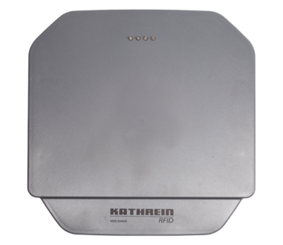
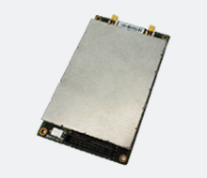

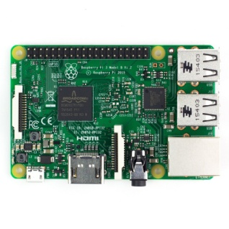
Overview of the equipment of a node (checkpoint)
2 Antennas
RFID Reader
Power Banks
Board Computer (Raspberry Pi 3)

Slide 21
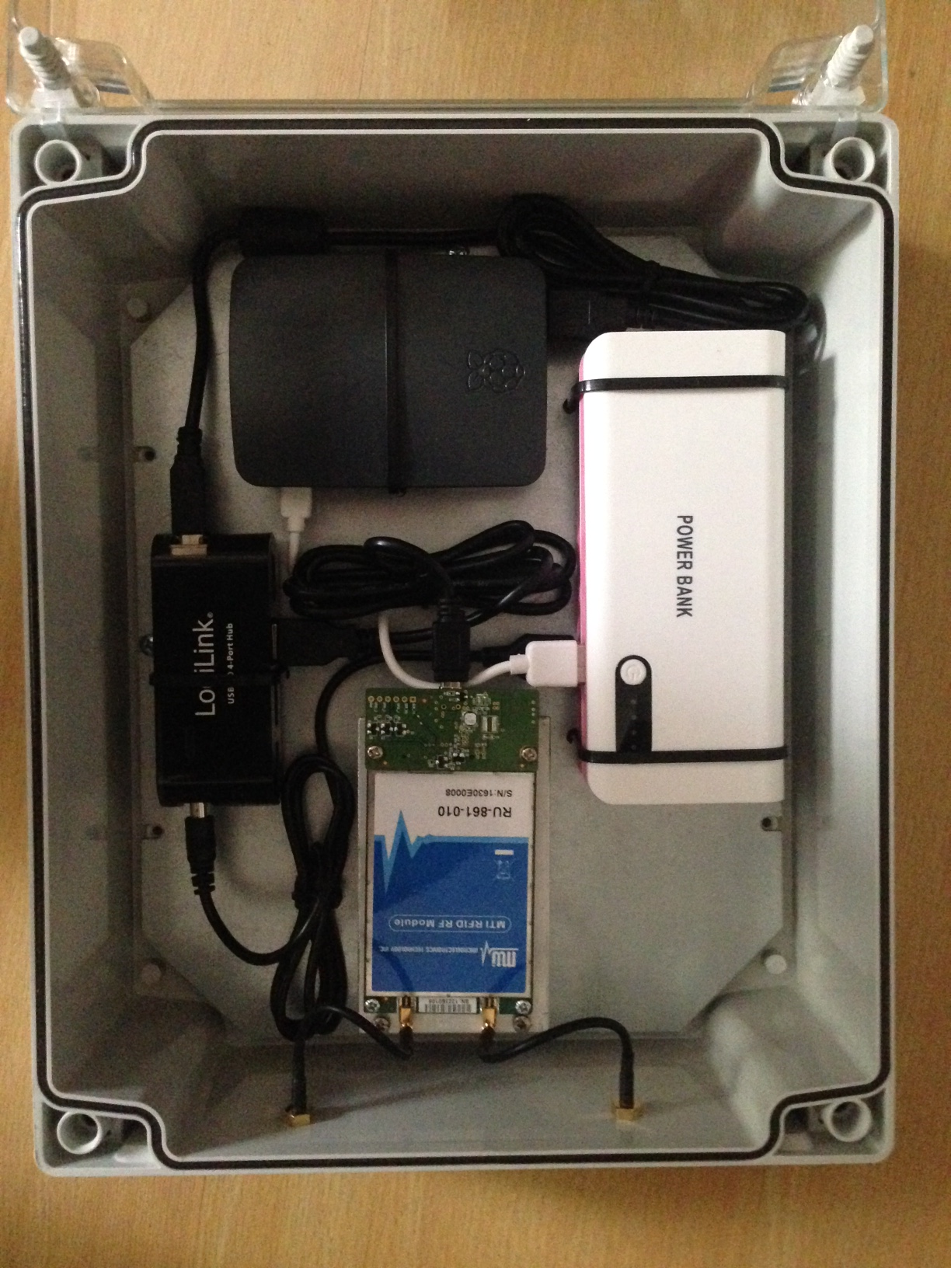
Overview of the equipment of a node (checkpoint)

Slide 22
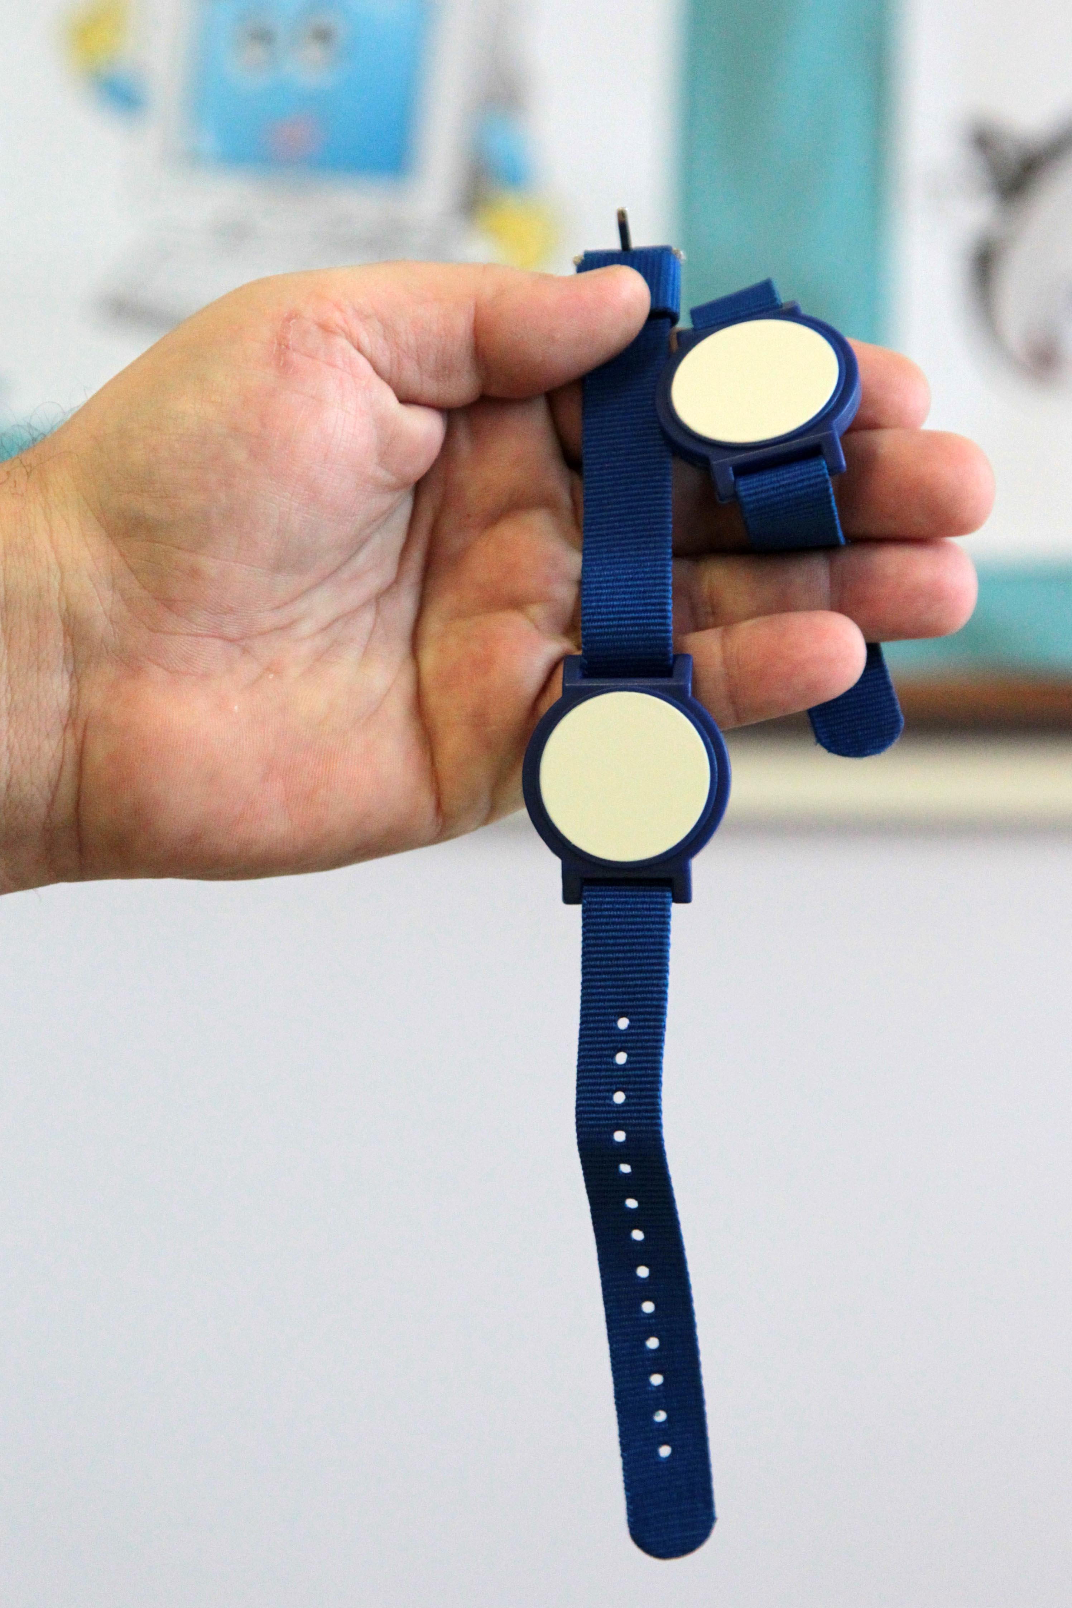

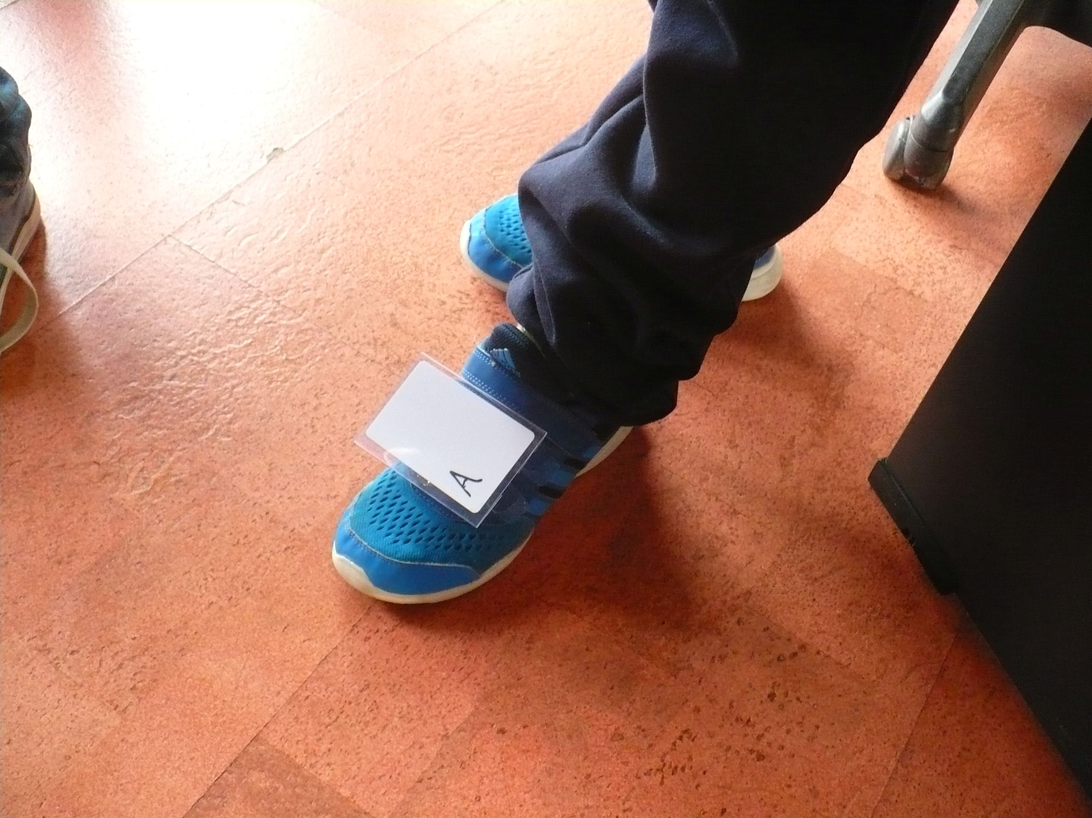
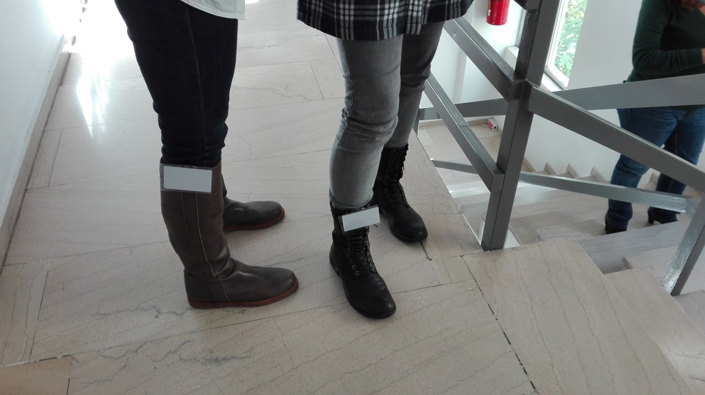
RFID tag placement

Slide 23
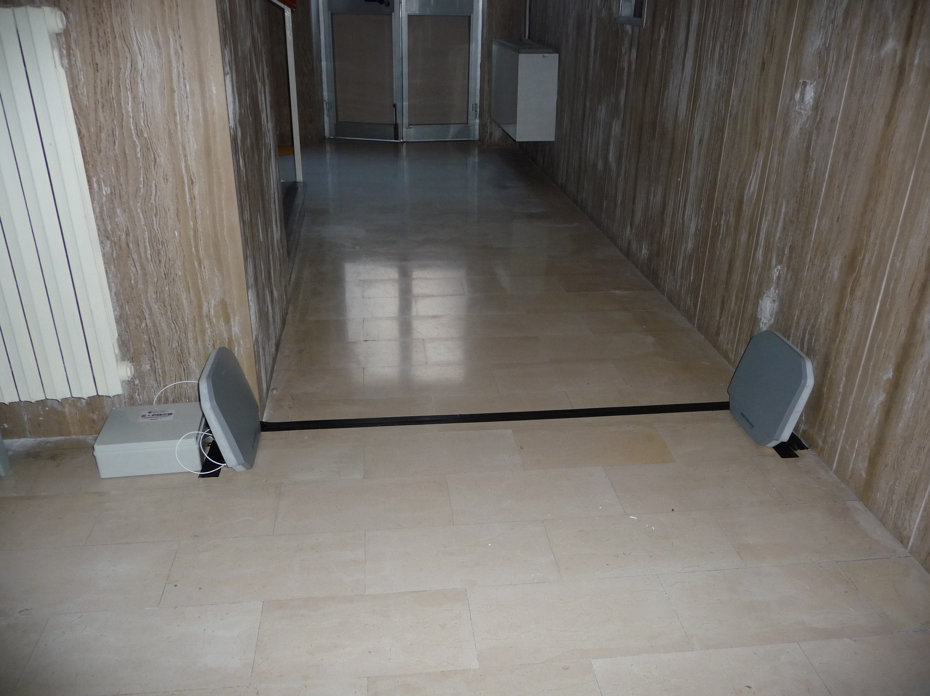
Node placement in a school

Slide 24
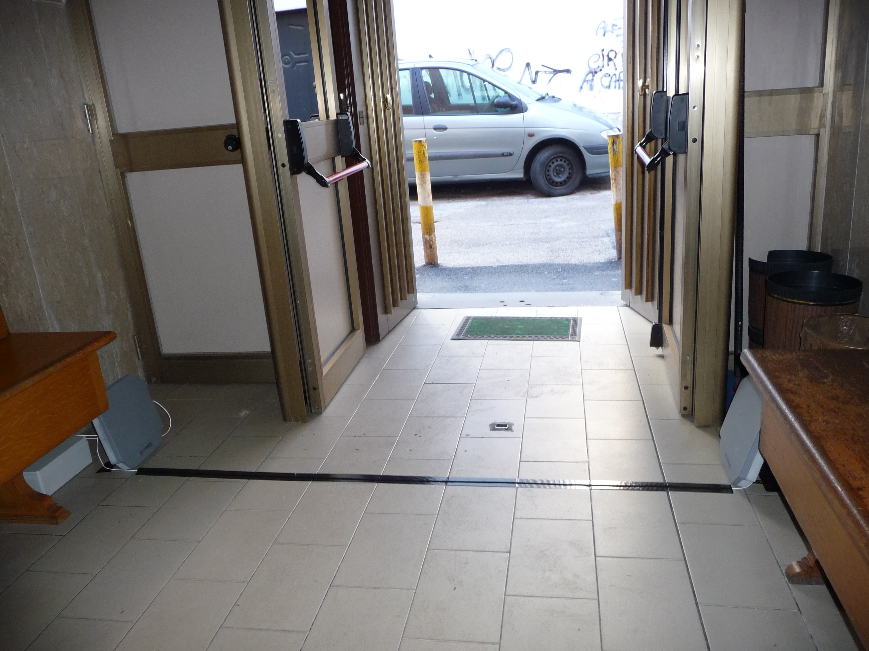
Node placement in a school

Slide 25
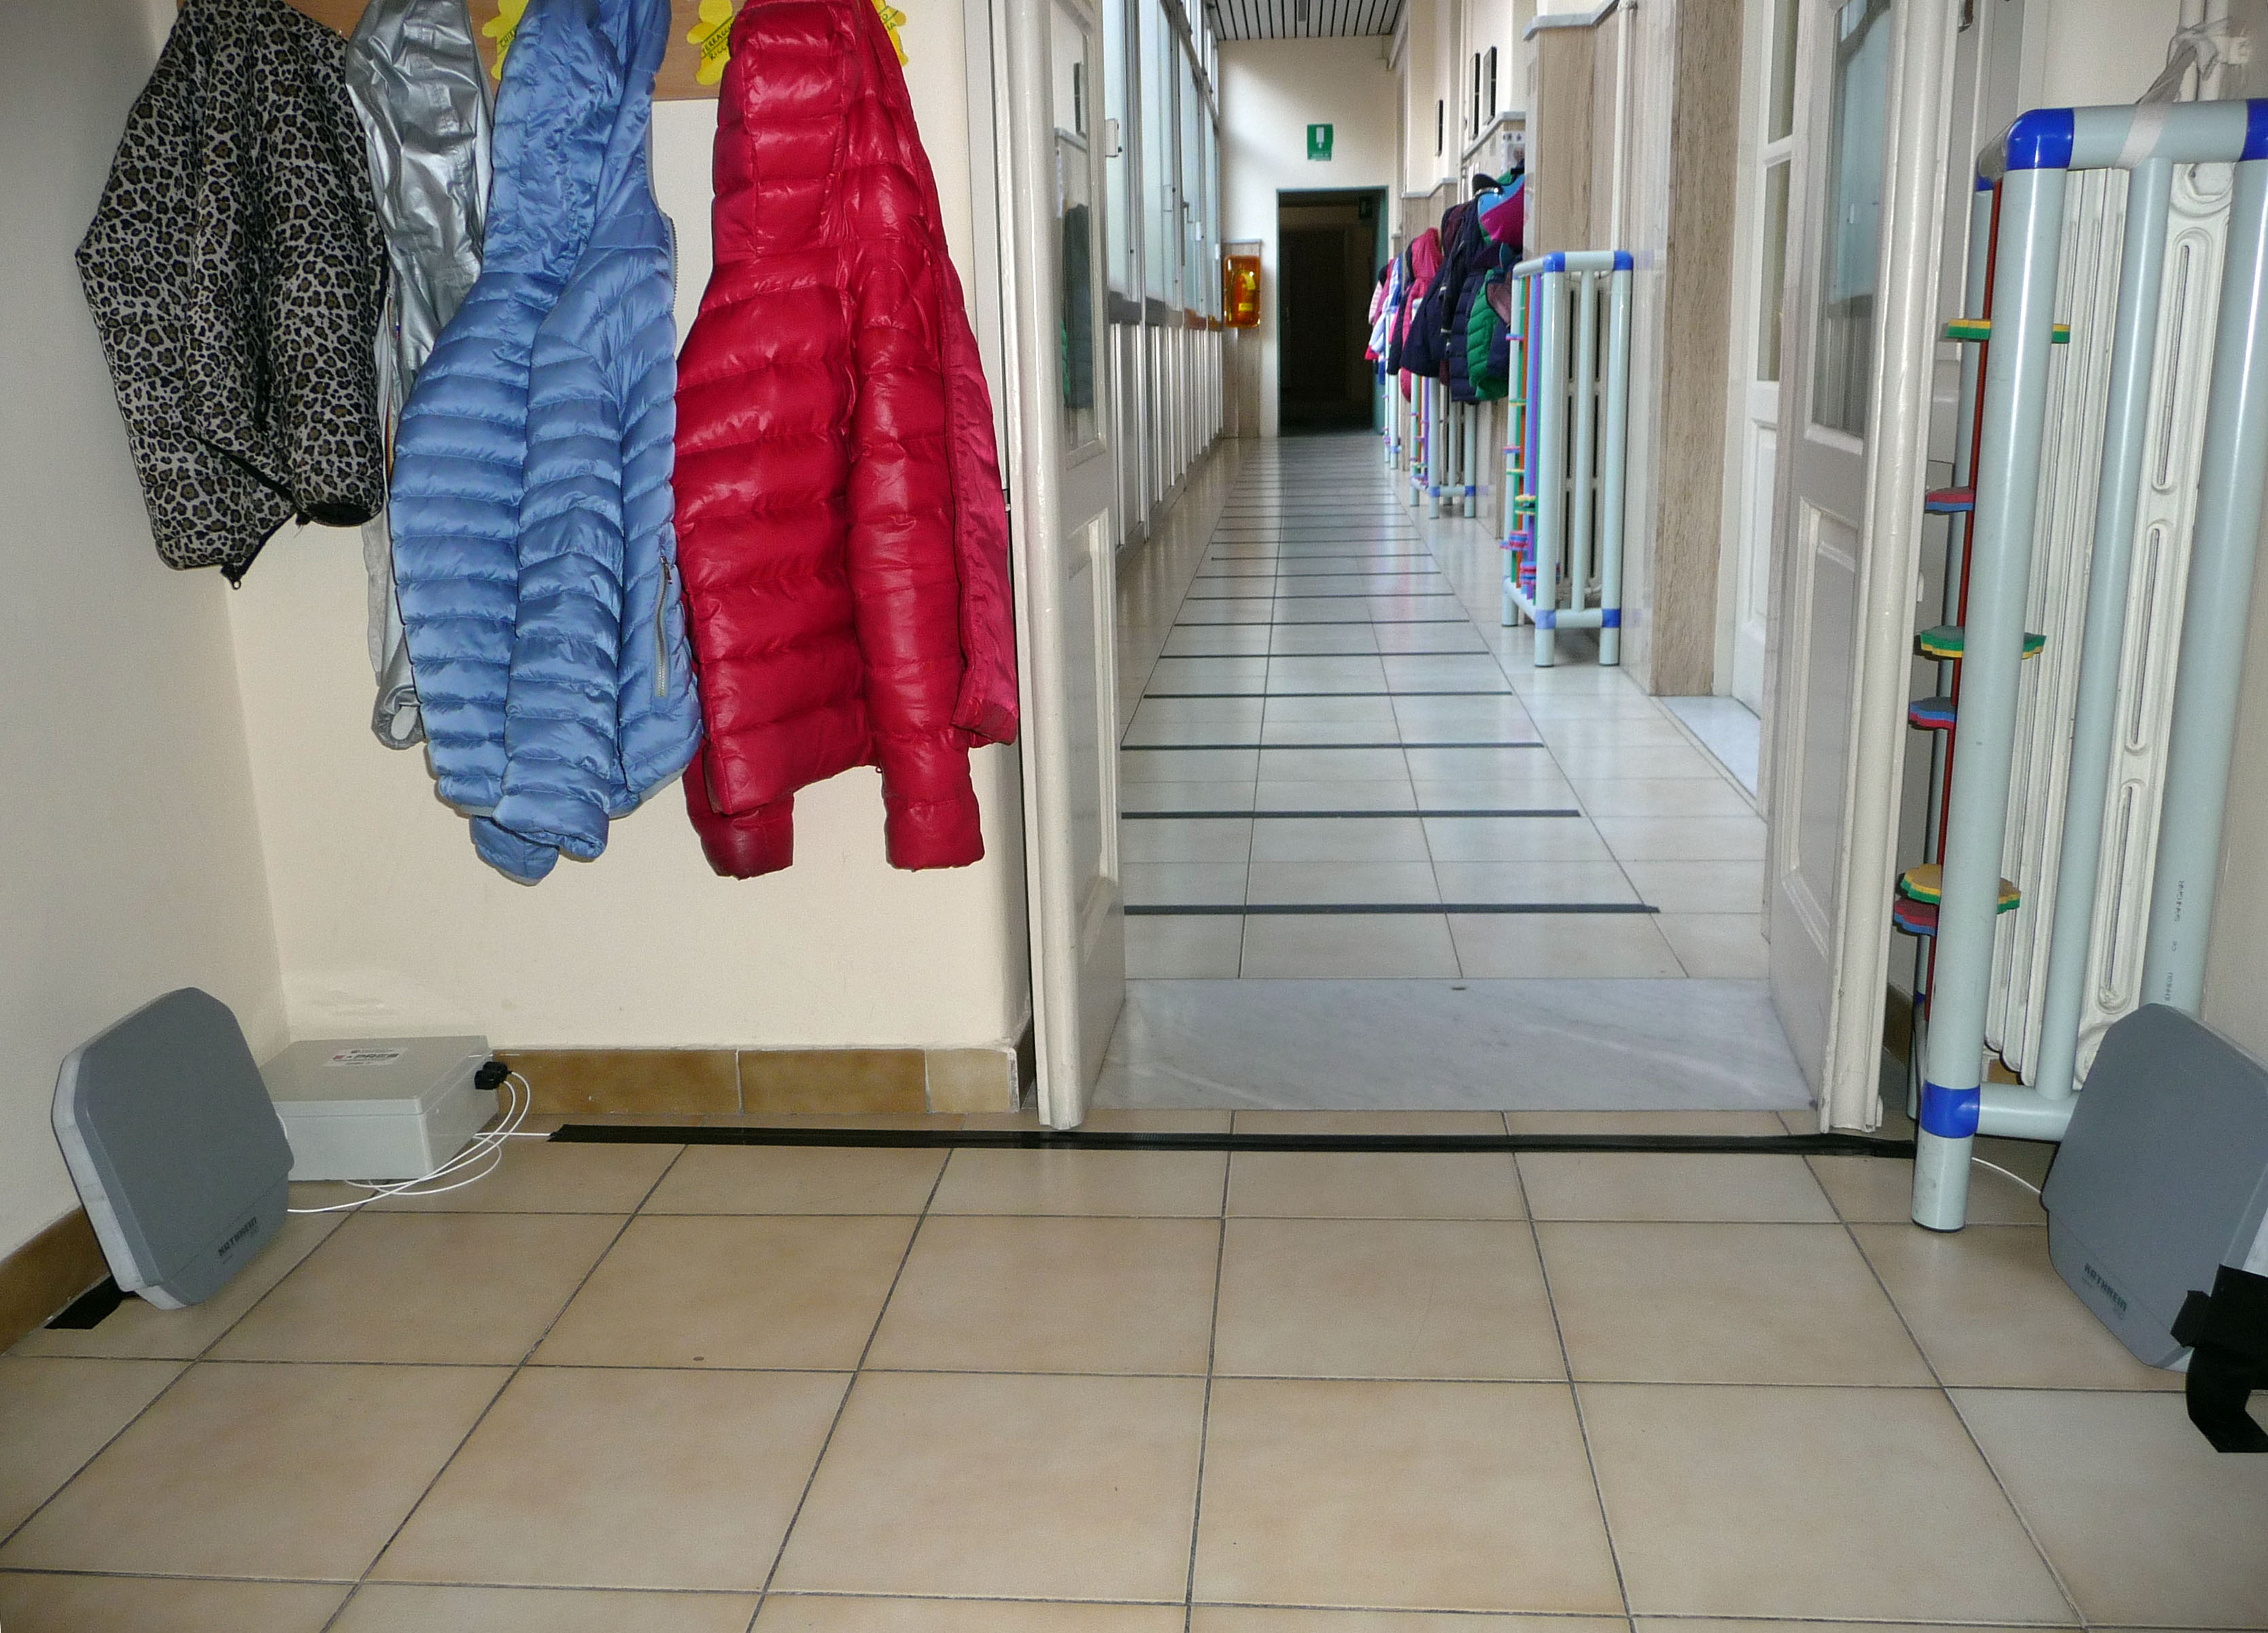
Node placement in a school

Slide 26
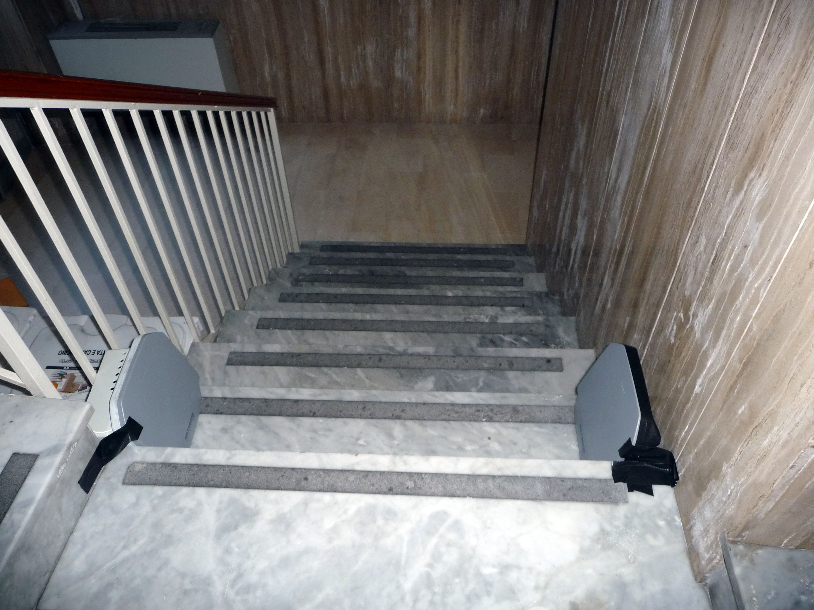
Node placement in a school

Slide 27
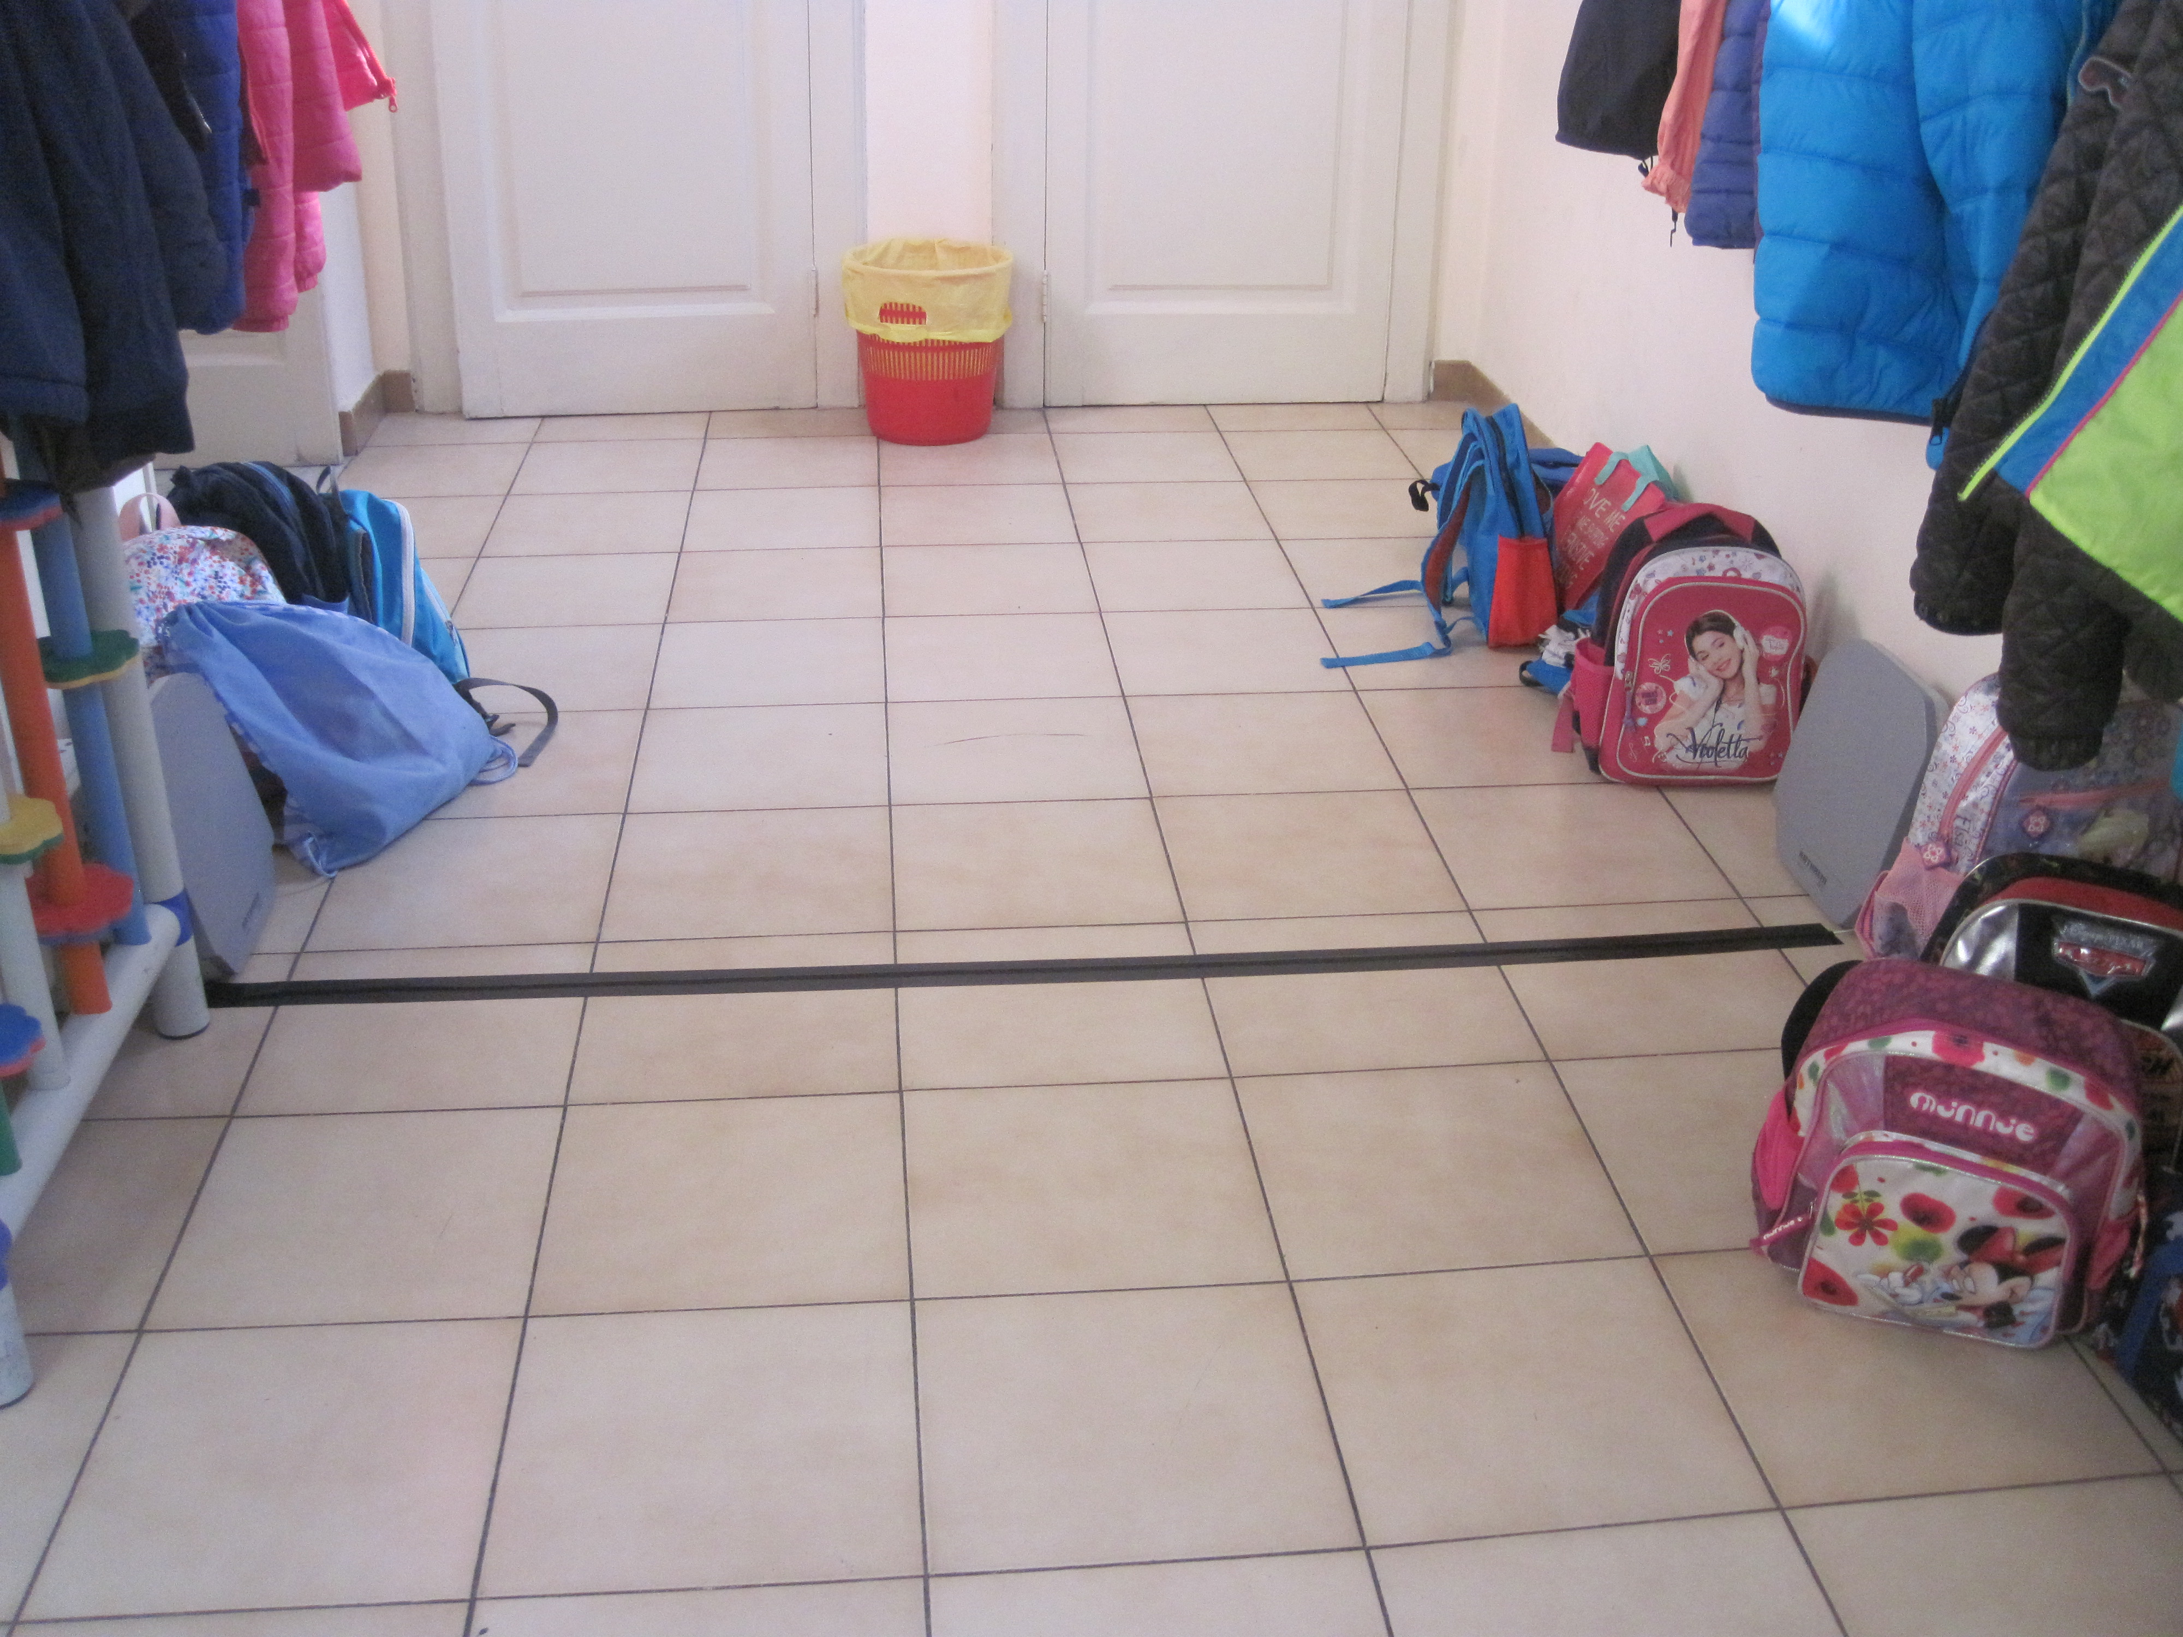
Node placement in a school

Slide 28
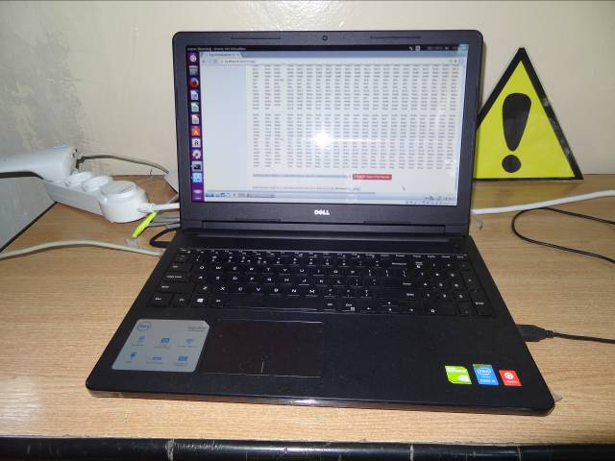
Server running on a VM on a Linux laptop

Slide 29
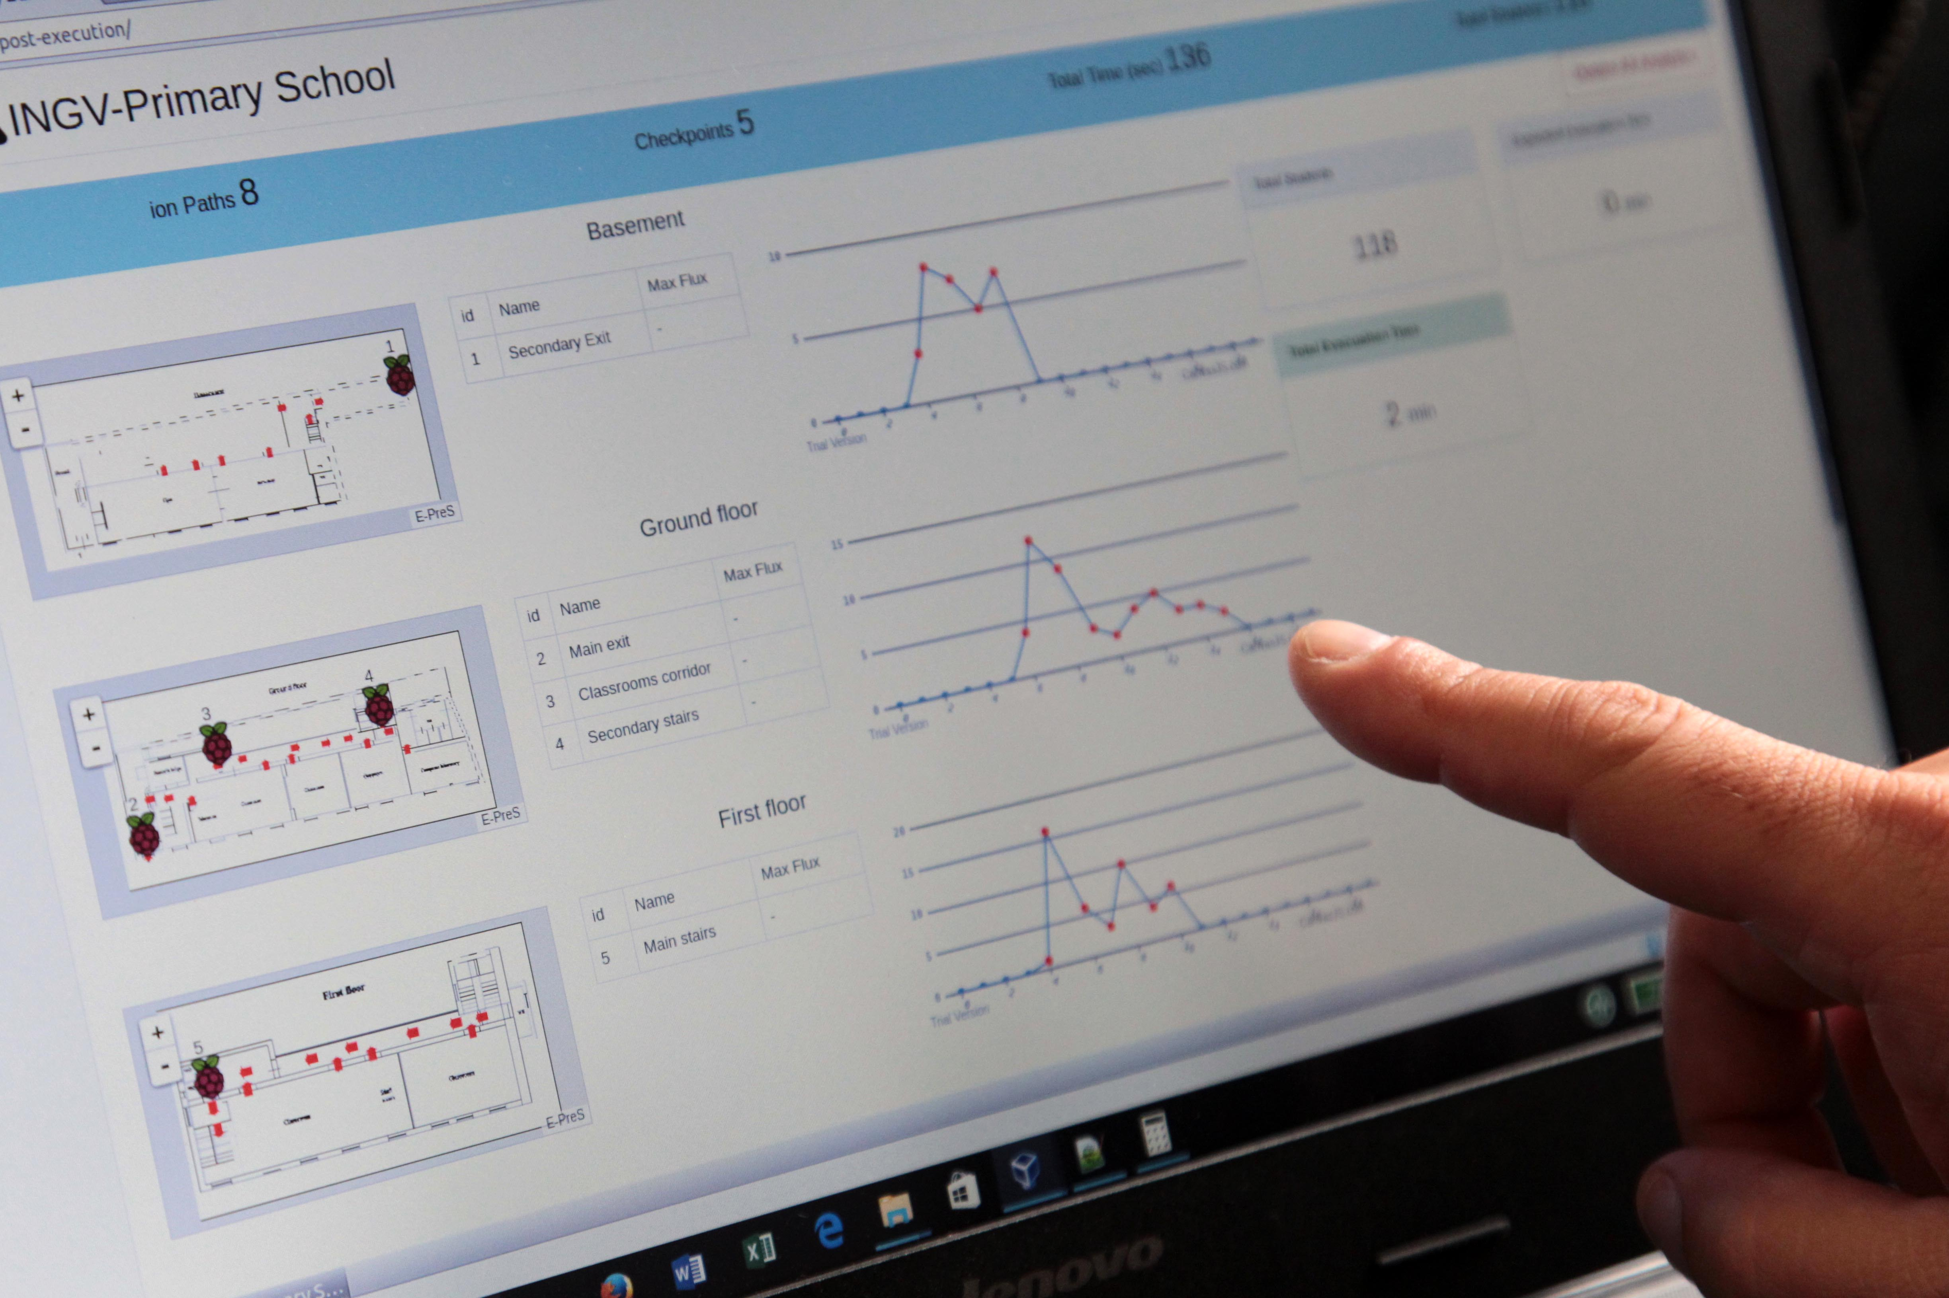
Real-time view

Slide 30
Field trials
EPPO (10/11/16 & 23/11/16)
NHMC – (22/1116 & 25/11/16)
INCD – (24/11/16)
CEI – (21/10/16 & 25/10/16)
INGV – (7/11/16 & 30/11/16)

Slide 31
Field trials results
The system worked as expected. No problems reported whatsoever, apart from occasional Wi-Fi network outage.
A Wi-Fi router could be used instead of Wi-Fi- repeaters to ensure system robustness.
The portability and use of the system in remote schools without Internet Connection was demonstrated.

Slide 32

Awards

Slide 33

Awards

Slide 34
Thank you for your attention!
E-PreS is an EU co-funded project.
Contract Number: ECHO/SUB/2014/698447
http://e-pres.di.uoa.gr/
http://p-comp.di.uoa.gr

